Slide 1
Telecom Targeted Marketing
Identifying Customers at risk of Churn and associated Cost

Slide 2
Current Churn Statistics
Churn Rate
Average monthly charges per customer

Slide 3
Trial
Size of Dataset
Feature Count
Stay/Churn Imbalance

Slide 4
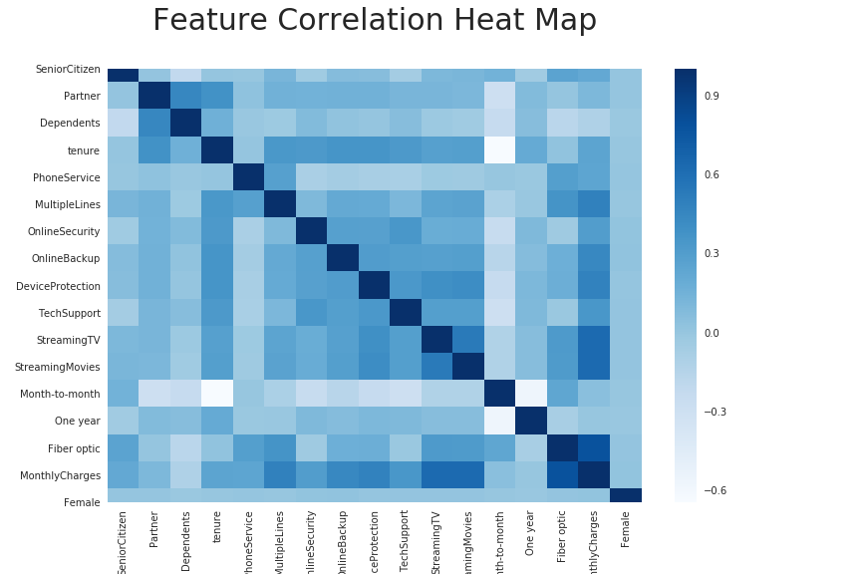
Tools Used

Slide 5
Methodology

Slide 6
Features Selected

Slide 7
Models Tested

Slide 8
Model Results

Slide 9
Model Selected and Test Results

Slide 10
Recommendations

Slide 11
References

Slide 12
Appendix

